Slide 1

Labelled face in the wild Prediction
Darryl Rusli

Slide 2
Bio
Darryl Rusli
Education:
Certification III at Information Technology at TAFE NSW
Certification IV at Programming at TAFE NSW
Certification IV Web Development at TAFE NSW
Diploma of Web Development at TAFE NSW
UTS accredited Certification of Data Science at IOD
Working Experience:
COVID-19 Administration Support
November 2020 – (Current)

Slide 3
Data Pipeline
Stakeholder
Model Evaluation
Model Recommendation
Questions
Data Description
Image Pre-processing
Context

Slide 4
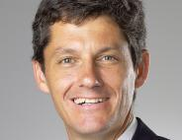
Stakeholders
Industry: University of Massachusetts Amherst (College of Information and Computer Sciences)
Professor: Erik Learned-Miller

Slide 5
University of Massachusetts Amherst CICS
College of Information and Computer Sciences, Professor have received the Award of Mark Ervingham Award from ICCV sponsored by IEEE
The award is given once a year by the Technical Committee on Patten Analysis and Machine Intelligence of the IEEE Computer society.
The Research Team Members Learned-Miller, Gary B Huang, Berg received the award for developing the Labelled Faces in the Wild
The Dataset have been used by known establish company like google and face to test face-recognition accuracy

Slide 6
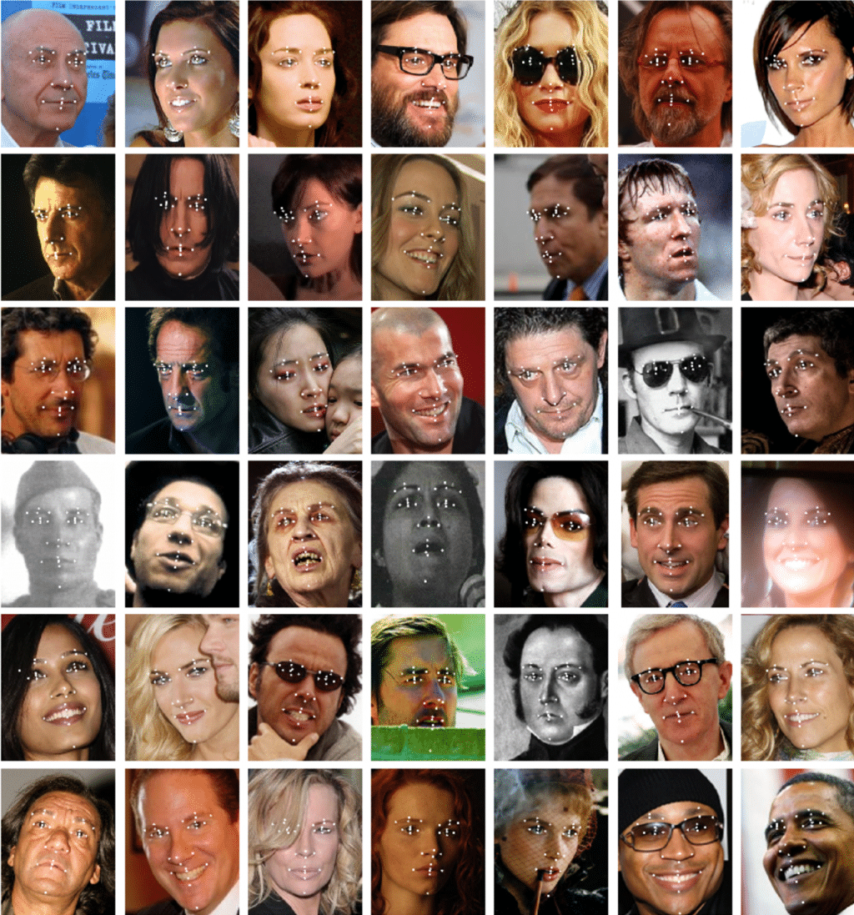
Labelled Faces in the Wild
The purpose of the data is for face verification and study the unconstrained face recognition. As it is viewed one of the most fundamental face recognition problem
The data contain more than 13,000 images collected from the web with the name of the person pictured.
Furthermore, it is also published to assist research community making advances in face verification.
Each face has been labelled with name of the person required

Slide 7
Questions
Business Question
How to solve the problem of unconstrained face recognition.
Why asking this question:
Unconstrained face recognition is one of the fundamental face recognition problem
Data Question
What model that can also help to name the person on the photo correctly

Slide 8
Dataset Description
Name of the Dataset: Labelled Face in the Wild
The data was developed by Researcher at University of Massachusetts Amherst CICS
Tara Berg
Gary B Huang
All of the images have different angle, expression, pose, resolution and brightness
Dataset contains
7 different type of people (Target/Class): Ariel Sharon, Colin Powel, Donald Rumsfeld, George W Bush, Gerhard Schroeder, Hugo Chavez, Tony Blair
Height: 298
Width: 224
Samples: 1288 samples
Training: 966
Test: 322
Greyscale
Source: University of Massachusetts Amherst CICS

Slide 9
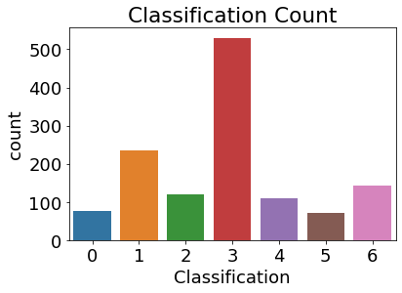
Exploratory Data Analysis
The only limitation about the data is that target is imbalanced as classification 3 which represents George W Bush cover the majority of the whole data
Classification | Target Name
0 | Ariel Sharon
1 | Colin Powell
2 | Donald Rumsfeld
3 | George W Bush
4 | Gerhard Schroeder
5 | Hugo Chavez
6 | Tony Blair

Slide 10
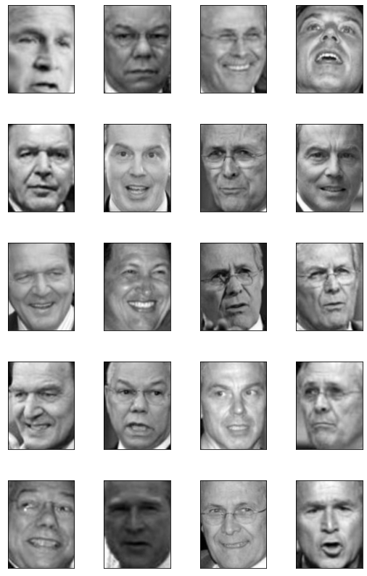
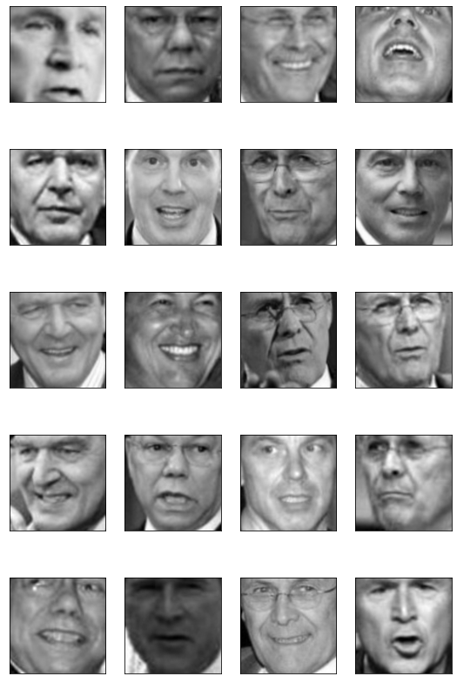
Image Pre-processing
Normalise the Data
Images were originally rectangle shape (298 x 224)
Images were cropped to square shape (224 x 224) before Alexnet Image Processing

Slide 11
Tested Models
VGG16
Alexnet
Resnet50

Slide 12
Model Recommendation
Model | Accuracy | Loss | Training Time
Alexnet | 82% | 0.85 | 2 hours 13 minutes
Resnet 50 v1 | 61% | 1.75 | 5 hours 31 minutes
VGG16 | 65% | 7.6 | 6 hours 15 minutes
Alexnet is chosen as the best model as the model performing well when it comes Accuracy and train the shortest time where the others model take much longer times to train. Additionally, it has 8 layers.

Slide 13
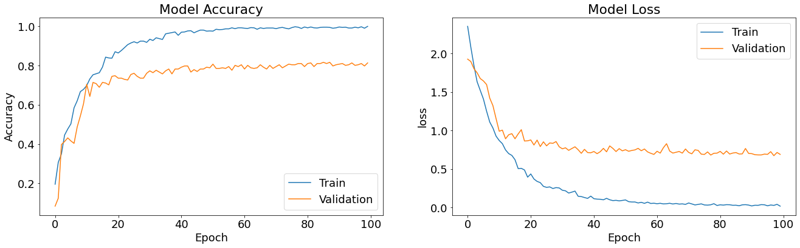
Alexnet Models Evaluation

Slide 14
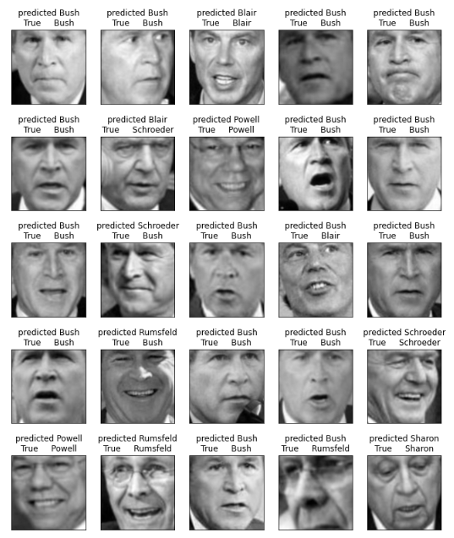
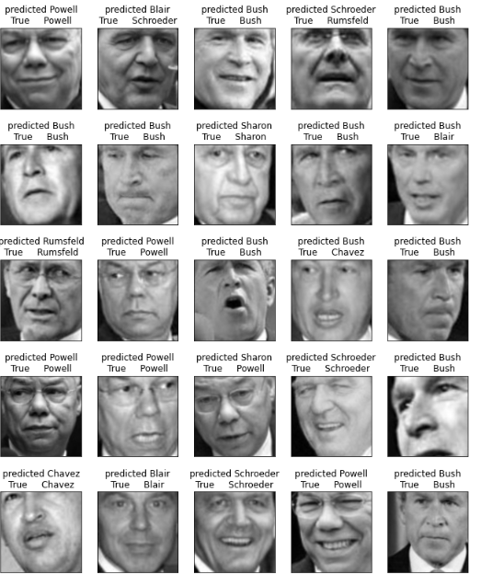
Alexnet Prediction Outcome
Based on insight that we get from this analysis, the CNN Model can predict the name of the person with very minimal misprediction.

Slide 15
Summary
From the 3 models that have been tested, Alexnet is the best model to name the person in the picture accurately with the minimal loss value and can train in a shorter time than the other model
To solve the problem of unconstrained facial recognition, Viola-Jane Detection were implemented to all of the images to do the face recognition which minimize the error by eliminating the false positive results
Limitations:
Imbalanced Target as classification 3 which represents George W Bush has the biggest count amongst the other classification
Not enough groups and groups are represented well such as no children, no babies, no people over 80 and no women
Future Applications:
Collecting more observations and groups such as children, babies, people over 80 and women so that way the LFW can provide more evidence that the model is accurate to do face recognition
Implementing other CNN Models like Faster R-CNN Resnet V1, CenterNet Resnet50 V2, and ResNet 29 and test the CNN Model on the data with additional group types as mentioned above to do the Face Recognition Accuracy.

Slide 16
References
http://vis-www.cs.umass.edu/lfw/
https://www.umass.edu/news/article/cics-professor-erik-learned-miller

Slide 17
Thank you
Any Question?

